Slide 1
PROFESSOR VELAZQUEZ
INTRODUCTION
TO
MICROECONOMICS
MODULE 05 · FACTOR MARKETS
FALL 2025

Slide 2
05
Factor Markets
Section I establishes the terms of distribution: how the market model inverts, what derived demand is, and how VMP determines what a factor is paid. Section II runs that model through the three factor markets — land, labor and capital — with historical case studies for each.
MODULE

Slide 3
MODULE 5
Agenda, Big Questions & Do Now
BIG QUESTIONS
PRE-WORK
WHAT YOU'LL NEED
(1) How are wages, rents, and interest rates determined in competitive factor markets?
(2) Under what conditions does a worker's wage equal the value they add — and when does that prediction break down?
· Read Chapter 18 (The Markets for the Factors of Production)
· Complete the Module 5 Vocabulary Checklist
· Khan Academy: Factor Markets — reach mastery
· Bring the Module 5 Worksheet and graph paper
· Review Module 3 (equilibrium) and Module 4 (elasticity) — both are load-bearing today
· Module 5 Worksheet (printed)
· Pencil, straight-edge, calculator
· Graph paper for the land, labor and loanable-funds diagrams
· Your Module 2 notes on Marcus, Ray, Julia and Marco
DO NOW · OPENING INQUIRY
Why does Marcus earn $15 per hour while Ray collects rent, interest, and profit? This module models how wages, land rents and interest rates are determined — and under what conditions those prices reflect the value that workers and resources actually contribute.
AGENDA — DAY 1 · TERMS OF DISTRIBUTION | TIME | AGENDA — DAY 2 · THE THREE FACTOR MARKETS | TIME
Do Now + the inversion of the market model | 10 min | Do Now: who captures neighborhood growth? | 5 min
Part 1 — Product vs. factor markets; derived demand | 25 min | Part 2 — The market for land; the Enclosure Movement | 25 min
Part 1 — VMP = P × MP; the Florentine cloth merchant | 25 min | Part 3 — The market for labor; the Great Migration; monopsony | 25 min
Part 1 — The distribution sequence; Britain & Bengal | 15 min | Part 4 — Loanable funds; three credit-market shocks | 20 min
INTRO TO MICROECONOMICS | PROF. VELAZQUEZ
MODULE 5: FACTOR MARKETS

Slide 4
BEFORE WE BEGIN
Vocabulary Checklist — Module 5
Product Markets
Factor Markets
Derived Demand
Marginal Product of Labor (MPL)
VMP = P × MP
Marginal Revenue Product (MRP)
Price Taker
Labor Market Equilibrium
Wage Rate
Rental Price
Purchase Price
Perfectly Inelastic Supply (land)
Economic Rent
Loanable Funds
Interest Rate
Enclosure Movement
Great Migration
Capital Deepening
Monopsony (preview)
Average / Marginal Cost of Labor
THE ONE SENTENCE THIS MODULE TURNS ON
In a competitive market, a factor of production is paid the VALUE OF WHAT IT ADDS AT THE MARGIN. Everything in Section I builds that claim; everything in Section II tests it.
INTRO TO MICROECONOMICS | PROF. VELAZQUEZ
MODULE 5: FACTOR MARKETS

Slide 5
SECTION I
Terms of Distribution
Part 1 · Product markets vs. factor markets — and the inversion of who supplies and who demands
Part 1 · The two neoclassical assumptions; derived demand; VMP = P × MP and the hiring rule
Part 1 · The distribution sequence: capital → productivity → wages → income, and its global ripple

Slide 6
01
Derived Demand & the
Value of Marginal Product
PART
OBJECTIVE Distinguish product from factor markets; define derived demand; derive VMP = P × MP; trace the distribution sequence from capital to wages.
INTRO TO MICROECONOMICS | PROF. VELAZQUEZ
MODULE 5: FACTOR MARKETS

Slide 7
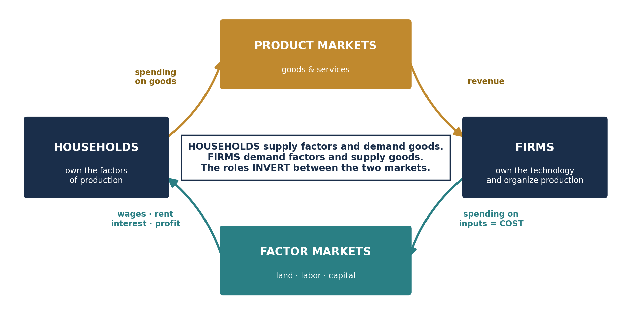
PART 1 · THE INVERSION
Product Markets vs. Factor Markets
PRODUCT MARKETS
FACTOR MARKETS
Markets where GOODS AND SERVICES are bought and sold.
Who SUPPLIES? Firms.
Who DEMANDS? Households (consumers).
The 'price' is the market price of the good.
EXAMPLE FROM THIS COURSE: the market for wheat, silk, spearheads, salt — Modules 3 and 4.
Markets where the FACTORS OF PRODUCTION — land, labor, capital and innovation — are bought and sold.
Who SUPPLIES? Households (they own the factors).
Who DEMANDS? Firms (they need the inputs).
The 'price' is the wage, the rent, or the interest rate.
THREE FACTOR MARKETS IN MODULE 5: land, labor, capital.
THE FIVE-STEP CYCLE
1. Firms decide how much to PRODUCE based on consumer demand in PRODUCT markets.
2. To produce, firms must PURCHASE inputs in FACTOR markets.
3. The demand for inputs is DERIVED from the demand for the final product.
4. The price of each input — wage, rent, interest rate — is determined by SUPPLY AND DEMAND in its own factor market.
5. Income earned in factor markets (wages + rent + interest + profit) flows BACK to households, who then PURCHASE goods in product markets. The cycle continues.
INTRO TO MICROECONOMICS | PROF. VELAZQUEZ
MODULE 5: FACTOR MARKETS

Slide 8
PART 1 · THE SCAFFOLDING
The Two Neoclassical Assumptions & Derived Demand
1
ALL MARKETS ARE COMPETITIVE
2
FIRMS HAVE DEMAND TOO
Firms are PRICE TAKERS — they do NOT set price. The market price is determined by the MARKET as a whole, not by any single firm.
This assumption is what lets us write P as a fixed number in the VMP formula. Modules 10 and 11 remove it, and the whole distribution result changes.
Firms are not only SUPPLIERS of goods — they are also DEMANDERS of inputs (labor, capital, land). Their primary goal is to MAXIMIZE PROFIT.
KEY IMPLICATION: if firms are price takers, the only way left to raise profit is to MINIMIZE COST — which means deciding carefully how much of each factor to employ.
DERIVED DEMAND
VALUE OF MARGINAL PRODUCT (VMP)
The demand for a factor of production is NOT DIRECT. It is DERIVED from a firm's decision to supply a good in the PRODUCT market.
No firm wants weavers for their own sake. It wants cloth — and weavers are how cloth gets made. If cloth demand collapses, weaver demand collapses with it, however skilled the weavers are.
The dollar value added to output by one additional unit of a factor.
VMP = Price of the Good × Marginal Product
In perfect competition Price = Marginal Revenue, so VMP = MRP (Marginal Revenue Product). We will use the two interchangeably until Module 10 forces us to separate them.
HIRING RULE: hire up to the point where VMP = WAGE
Wage = price of the good produced × the amount of that good produced by one additional worker.
Hiring one more worker BEYOND this point would LOWER profit, because that worker adds less value than they cost.
INTRO TO MICROECONOMICS | PROF. VELAZQUEZ
MODULE 5: FACTOR MARKETS

Slide 9
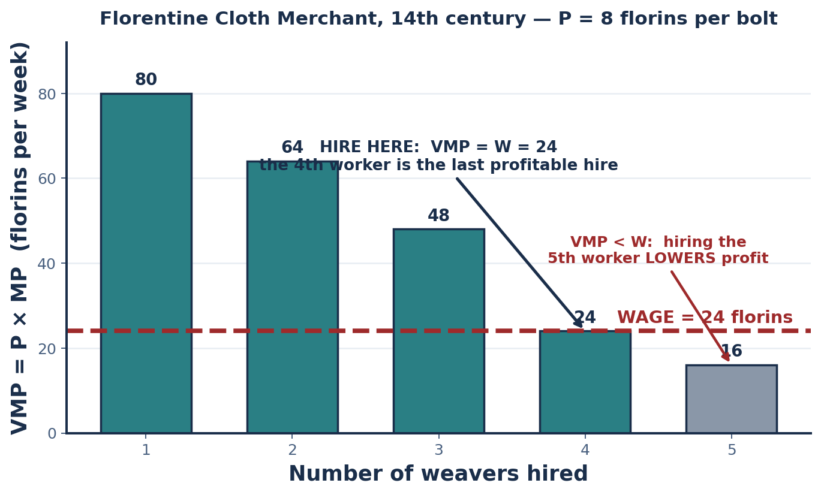
SCENARIO 5.1 · FLORENCE, 14TH CENTURY
The Florentine Cloth Merchant — Deriving VMP
A cloth merchant hires weavers at a wage of 24 florins per week. Each bolt of cloth sells at 8 florins. Use the marginal product schedule to derive VMP and identify how many workers to hire.
WORKERS | MP (bolts/wk) | VMP = P × MP | WAGE | HIRE? (VMP ≥ W)
1 | 10 | 8 × 10 = 80 | 24 | YES — adds 56 net
2 | 8 | 8 × 8 = 64 | 24 | YES — adds 40 net
3 | 6 | 8 × 6 = 48 | 24 | YES — adds 24 net
4 | 3 | 8 × 3 = 24 | 24 | YES — adds 0 net (the margin)
5 | 2 | 8 × 2 = 16 | 24 | NO — LOSES 8
Hire until VMP = WAGE → 4 workers
WHY MP FALLS — AND SO VMP FALLS
This is the LAW OF DIMINISHING MARGINAL PRODUCT from Module 2, arriving with a price attached. Because P is fixed for a price taker, the VMP curve inherits its downward slope entirely from MP — which is why the VMP curve IS the firm's labor demand curve.
INTRO TO MICROECONOMICS | PROF. VELAZQUEZ
MODULE 5: FACTOR MARKETS

Slide 10
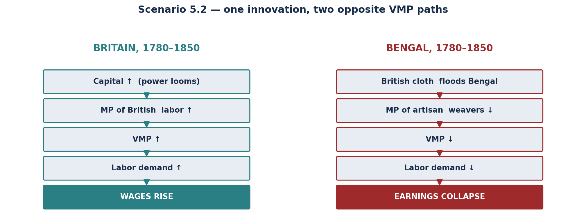
SCENARIO 5.2 · BRITAIN & BENGAL, 1780–1850
The Industrial Revolution — A Global Ripple
STEP | WHAT HAPPENED | THE MECHANISM
1 | British industrialists invest heavily in spinning jennies, water frames and steam-powered looms. | An increase in CAPITAL — a factor of production. This is CAPITAL DEEPENING: more capital per worker.
2 | As more machinery is installed, each new machine adds slightly less value. | The law of DIMINISHING MARGINAL PRODUCT applies to capital too. The RENTAL PRICE of capital FALLS as machinery becomes common.
3 | With better machines, each British worker becomes more PRODUCTIVE — more fabric per hour. | This raises the MARGINAL PRODUCT of LABOR, which raises the VALUE OF MARGINAL PRODUCT of each worker.
4 | Because each worker is now more valuable, firms increase their DEMAND for labor. | Labor demand (= VMP) shifts RIGHT. This pushes WAGES upward, increasing worker income.
5 | Britain imported raw cotton from Bengal, mass-produced cloth, and exported it back to India. | Britain's capital deepening raised domestic PRODUCTIVITY and demand while UNDERMINING India's artisanal economy — a direct example of how factor market shifts ripple across global markets. The word for this is INTERDEPENDENCE.
INTRO TO MICROECONOMICS | PROF. VELAZQUEZ
MODULE 5: FACTOR MARKETS

Slide 11
PART 1 · WORKSHEET ✦1
Does the VMP Mechanism Explain the Divergence?
THE QUESTION
The Industrial Revolution raised wages in one hemisphere while depressing effective wages in another — all through the VMP mechanism. Is this outcome consistent with competitive factor market theory, or does it require additional explanatory variables (colonial policy, market power, terms of trade)? What evidence would resolve the question?
1
THE CASE FOR 'CONSISTENT'
2
THE CASE FOR 'INSUFFICIENT'
3
WHAT EVIDENCE WOULD SETTLE IT
The model needs no extra machinery to produce this result. A technological shock raises MP where the technology is installed and destroys the MP of the substitute technique elsewhere. Both wage movements follow directly from VMP = P × MP.
On this reading, Bengal's weavers were outcompeted by a genuinely superior production technique, exactly as Ricardo and Schumpeter would predict.
The competitive model assumes both parties face the SAME prices and can freely enter any market. In fact:
· British tariffs on Indian finished cloth, and free entry for British cloth into India, were POLICY, not technology.
· The East India Company held monopsony power over Bengali raw-cotton purchases.
· The terms of trade were set by an occupying administration, not by a market.
Each of these is a variable OUTSIDE the model.
Compare the price of Indian cloth in Britain WITH and WITHOUT the tariff — if Indian cloth was competitive at world prices before the duty, technology alone does not explain the collapse.
Compare raw-cotton prices paid in Bengal with those paid in markets the Company did not control.
Look for a counterfactual region: a textile economy exposed to the same technology WITHOUT colonial policy.
The model is not wrong. It is INCOMPLETE.
VMP explains the direction of the wage movements. It does not explain who was permitted to compete, at what prices, or under whose law. Module 7 is where we take that question seriously.
INTRO TO MICROECONOMICS | PROF. VELAZQUEZ
MODULE 5: FACTOR MARKETS

Slide 12
SECTION II
Factor Market Models
Part 2 · The market for land: perfectly inelastic supply and the English Enclosure Movement
Part 3 · The market for labor: equilibrium wage determination, the Great Migration, and a monopsony preview
Part 4 · The market for capital: loanable funds, the interest rate, and three historical credit shocks

Slide 13
02
The Market for Land
PART
OBJECTIVE Model the market for land; explain perfectly inelastic supply; apply the Enclosure Movement case.
INTRO TO MICROECONOMICS | PROF. VELAZQUEZ
MODULE 5: FACTOR MARKETS

Slide 14
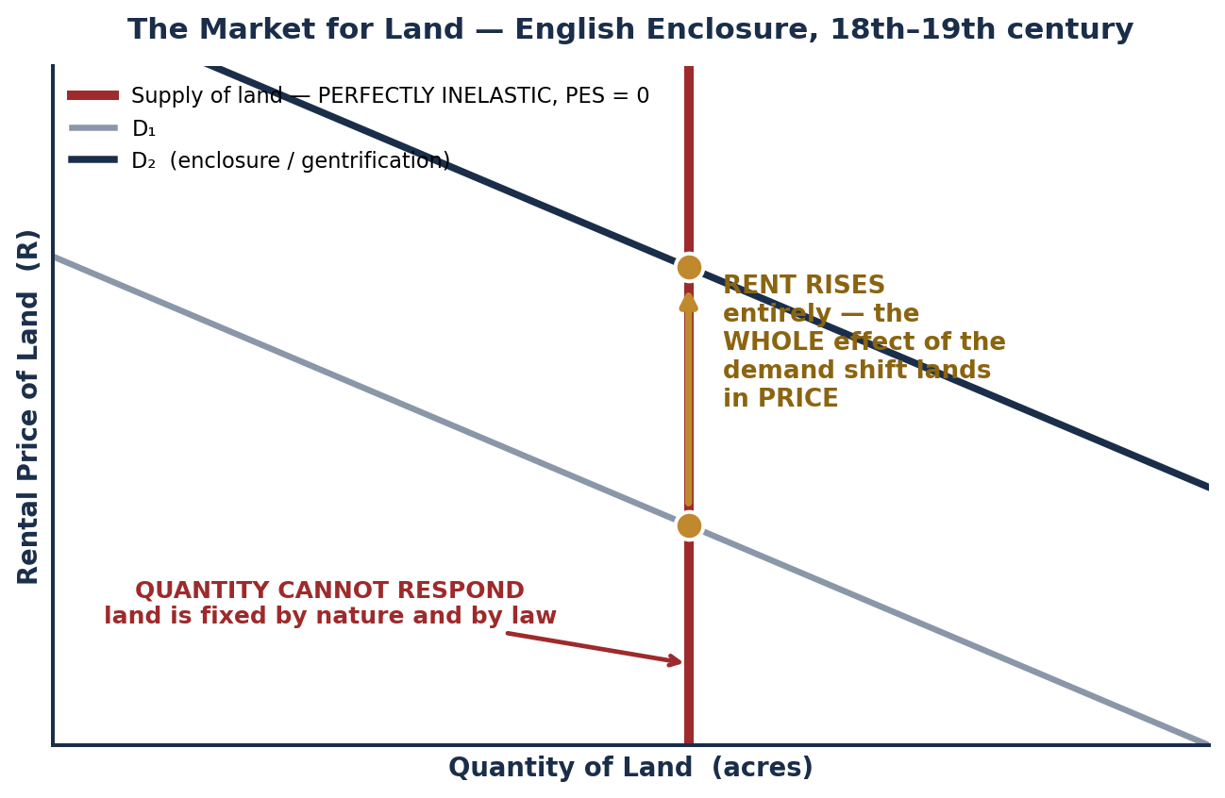
SCENARIO 5.3 · ENGLAND, 18TH–19TH CENTURY
The Market for Land & the Enclosure Movement
RENTAL PRICE vs. PURCHASE PRICE
RENTAL PRICE: the PERIODIC PAYMENT made to USE land for a specific period of time. This is what most people pay when they lease farmland or apartment space.
PURCHASE PRICE: the ONE-TIME price paid to OWN land outright.
We model the RENTAL price, because it is determined by supply and demand like any other market price.
WHY LAND SUPPLY IS SPECIAL
Unlike labor or capital, the total quantity of land is FIXED — it cannot be produced or destroyed. Land supply is therefore PERFECTLY INELASTIC: PES = 0, and the supply curve is VERTICAL.
When demand for land RISES: the RENTAL PRICE rises. The QUANTITY of land does not change AT ALL.
THE ENCLOSURE MOVEMENT — the historical case
Acts of Parliament converted communal agricultural land — the commons — into private property. The supply of tillable land became perfectly inelastic and LEGALLY FIXED. Rents rose; smallholders were dispossessed and pushed into wage labor.
The entire return accruing to a perfectly inelastic factor is called ECONOMIC RENT: a payment above what is necessary to keep the factor in its current use. Because supply cannot respond, that payment does nothing to increase the quantity supplied — it is pure transfer. (Ricardo, 1817.)
THE RAY QUESTION
Ray owns commercial property in Marcus's neighborhood. As the neighborhood gentrifies, Ray's rent RISES — the whole demand increase lands in price because his supply cannot expand. Does Marcus's wage automatically rise with the neighborhood? Only if the VMP of his labor rose — which gentrification does not guarantee.
INTRO TO MICROECONOMICS | PROF. VELAZQUEZ
MODULE 5: FACTOR MARKETS

Slide 15
PART 2 · WORKSHEET ✦2
Enclosure, Marcus and Ray — Who Captures the Gains?
THE QUESTION
The Enclosure Movement privatized the commons and created a landless proletariat compelled to sell labor. Map this structure onto Marcus and Ray: who holds the property and who supplies only labor — and what does the perfectly inelastic supply of land predict about who captures the gains from neighborhood growth?
 | ENGLAND, 1750–1830 | PHILADELPHIA, TODAY | WHAT THE MODEL PREDICTS
Holds the inelastic factor | The enclosing landholder — land supply is legally fixed at a stroke | Ray — commercial property, fixed in quantity | Captures the ENTIRE increase in demand as higher RENT, with no increase in quantity supplied. This is economic rent.
Supplies only labor | The dispossessed smallholder, now a wage laborer | Marcus — sells hours at a wage | Is paid VMP. VMP rises only if PRODUCTIVITY or the PRODUCT PRICE rises — neither of which follows from the neighborhood becoming more desirable.
What growth does | Rising grain demand raises land rents; wages track productivity, not land values | Gentrification raises property demand; wages track the labor market, not the property market | The gains from neighborhood growth accrue to the OWNER OF THE INELASTIC FACTOR. The two are different markets, and they clear independently.
Growth raises the return to the factor that CANNOT be reproduced.
This is why Ricardo (1817), Mill, and Henry George (1879) all converged on land as the analytically distinctive factor — and it is the structural claim underneath Module 7's inequality material.
INTRO TO MICROECONOMICS | PROF. VELAZQUEZ
MODULE 5: FACTOR MARKETS

Slide 16
03
The Market for Labor
PART
OBJECTIVE Model the labor market; analyze equilibrium wage determination; apply the Great Migration case and preview monopsony.
INTRO TO MICROECONOMICS | PROF. VELAZQUEZ
MODULE 5: FACTOR MARKETS

Slide 17
PART 3 · THE KEY INVERSION
Labor Markets Run the Market Model Backwards
FEATURE | PRODUCT MARKET | LABOR MARKET
Who DEMANDS? | Consumers (households) | FIRMS — and their demand curve IS the VMP curve
Who SUPPLIES? | Firms | WORKERS (households) — the labor-leisure frontier of Module 2
What is the 'price'? | The market price of the good | The WAGE RATE
The law of DEMAND says… | Higher price → lower quantity demanded | Higher wage → firms hire FEWER workers (they move up the VMP curve)
The law of SUPPLY says… | Higher price → higher quantity supplied | Higher wage → MORE workers willing to work (higher quantity of labor supplied)
Equilibrium condition | Qd = Qs at P* | Quantity of labor demanded = quantity supplied at W*, and W* = VMP
WHY THE INVERSION IS CONFUSING — AND HOW TO KEEP IT STRAIGHT
The vocabulary does not change: demand still slopes down, supply still slopes up, and equilibrium is still an intersection. What changes is WHO STANDS ON WHICH SIDE. Households, who were buyers in Module 3, are sellers here. Firms, who were sellers, are buyers. Write the two words 'firms demand' at the top of every labor-market diagram you draw.
COMPETITIVE PREDICTION: W* = VMP
INTRO TO MICROECONOMICS | PROF. VELAZQUEZ
MODULE 5: FACTOR MARKETS

Slide 18
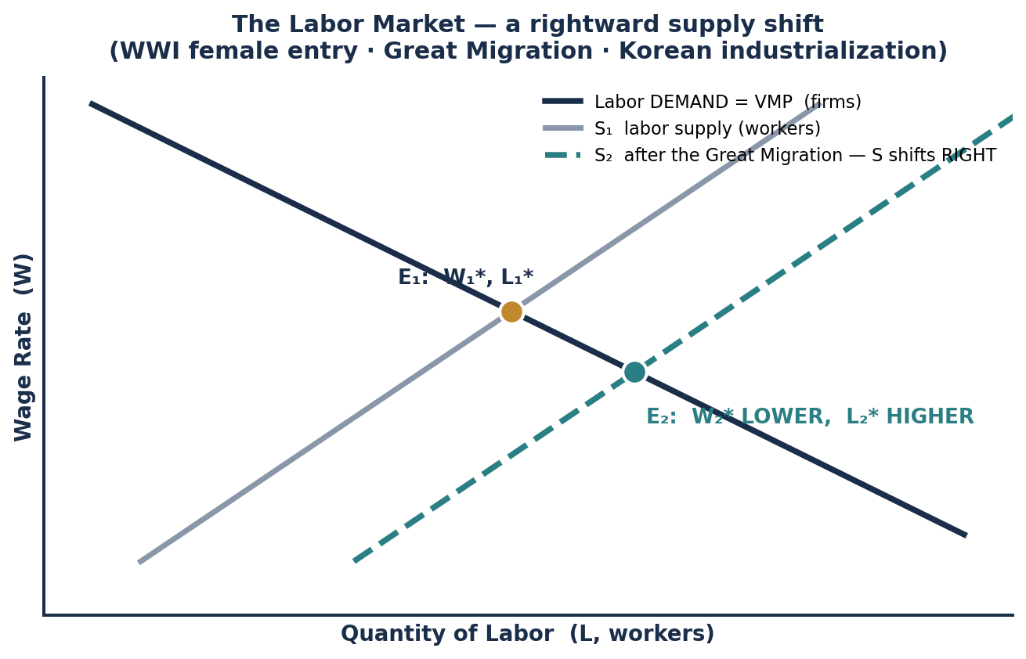
PART 3 · THREE LABOR SUPPLY SHOCKS
Historical Episodes in the Labor Market
HISTORICAL EPISODE | KEY LABOR MARKET SHIFT | PREDICTED EFFECT
WWI Female Labor Entry 1914–18 | Labor supply shifts RIGHT as women enter manufacturing | W* FALLS, L* RISES. Total wage bill may rise or fall depending on labor demand elasticity.
The Great Migration 1910–1970 | 6 million Black Americans migrate to Northern industrial cities — labor supply shifts RIGHT | W* FALLS, L* RISES in Northern cities; W* RISES in the Southern labor markets they left.
Korean Industrialization c. 1895 (Incheon) | Japanese colonial demand for industrial labor shifts labor DEMAND right | W* RISES, L* RISES. Note this is a DEMAND shift, not a supply shift — the effect on wages is the opposite sign.
✦3 DID WAGES BEHAVE AS PREDICTED?
COMPETITIVE THEORY PREDICTS: a large rightward supply shift lowers the Northern equilibrium wage. The historical record is more complicated. Black migrants were systematically excluded from the higher-VMP occupations by discrimination, occupational segregation and union exclusion — so the supply increase was concentrated in a narrow set of low-wage sectors rather than spread across the whole labor market.
The result: a large wage effect WITHIN certain occupations and almost none in others. That pattern is not predicted by a single-market competitive model, and it is the empirical case for Module 7's structural analysis.
Reading the diagram
Labor demand is the VMP curve — it does NOT move when supply moves. A supply shift therefore slides the economy ALONG the VMP curve, which is why W* and L* must move in OPPOSITE directions.
INTRO TO MICROECONOMICS | PROF. VELAZQUEZ
MODULE 5: FACTOR MARKETS

Slide 19
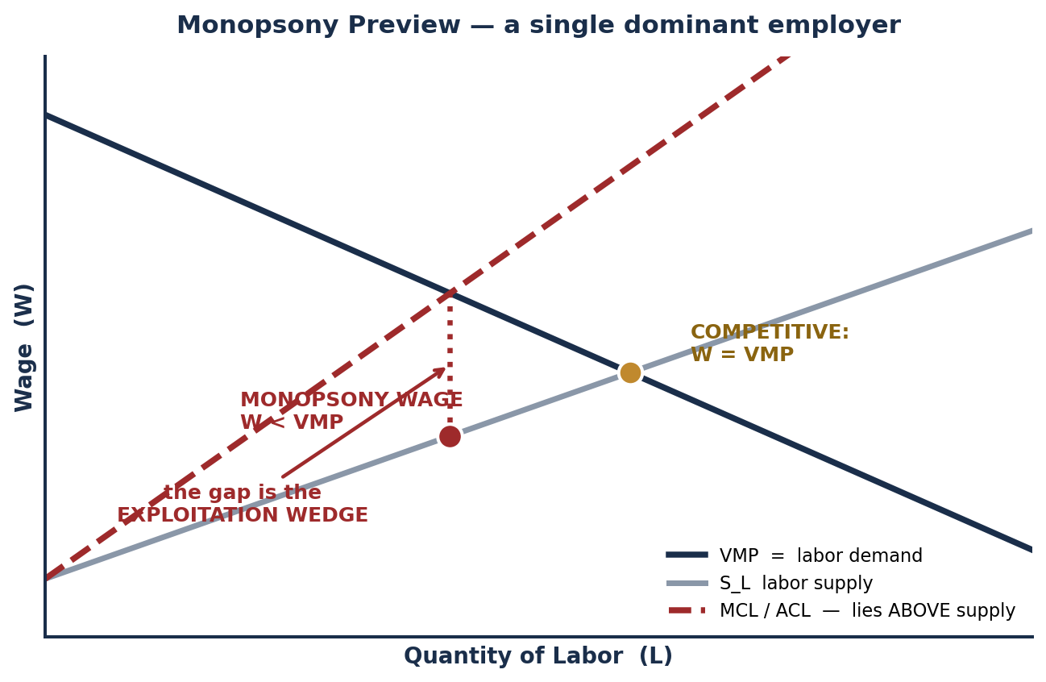
PART 3 · MONOPSONY PREVIEW
When W* Does Not Equal VMP
AVERAGE COST OF LABOR (ACL)
The total wage expenditure divided by the number of workers hired.
In a MONOPSONY, ACL RISES with each additional hire, because when the firm offers a higher wage to attract one more worker it must ALSO pay that higher wage to every existing worker.
The ACL and marginal-cost-of-labor curves therefore lie ABOVE the labor supply curve S_L.
THE CONSEQUENCE
The monopsonist hires where VMP = MCL, not where VMP = S_L. It then reads the WAGE off the supply curve at that lower quantity.
RESULT: the wage is BELOW VMP, and employment is BELOW the competitive level. Both the worker and total surplus lose.
IF RAY IS THE DOMINANT EMPLOYER
Wages will be BELOW VMP. Marcus is not underpaid because he is unproductive; he is underpaid because there is nowhere else within reach to sell the same hour. The gap between W and VMP is a measure of Ray's market power, not of Marcus's contribution.
Full treatment: Module 7.
The exam question this sets up
"Does Ray pay Marcus his VMP?" — In perfect competition, yes, necessarily. Away from it, the answer depends on how many employers Marcus can credibly walk to. Elasticity of labor SUPPLY facing the individual firm is the whole story (Module 4).
INTRO TO MICROECONOMICS | PROF. VELAZQUEZ
MODULE 5: FACTOR MARKETS

Slide 20
04
The Market for Capital:
Loanable Funds
PART
OBJECTIVE Model the loanable funds market; explain the interest rate as the equilibrating price; apply three historical cases.
INTRO TO MICROECONOMICS | PROF. VELAZQUEZ
MODULE 5: FACTOR MARKETS

Slide 21
PART 4 · THE SETUP
The Loanable Funds Market
THE 'PRICE' IS THE INTEREST RATE
SUPPLY comes from SAVERS
DEMAND comes from BORROWERS
The interest rate plays exactly the same role in the capital market that price plays in a product market: it is the variable that equilibrates the quantity supplied with the quantity demanded.
Module 2 gave you the interest rate as the opportunity cost of present consumption. This is the market that determines it.
Banks, investors, households and governments LENDING money — anyone deferring present consumption in exchange for a return.
The supply curve slopes UP: a higher interest rate rewards saving, so more funds are offered.
This is Marco, the lender, from Module 2.
Firms and households that want to borrow for INVESTMENT — plant, equipment, housing, a food cart.
The demand curve slopes DOWN: a higher interest rate means fewer investment projects clear the return-vs-rate test from Module 2.
This is Julia, the borrower.
RULE OF THUMB: Supply ↑ → r ↓ Demand ↑ → r ↑
Exactly the market model of Module 3, with r on the vertical axis instead of P.
THE CONNECTION BACK TO MODULE 2
Julia and Marco faced a given interest rate and chose a consumption path. Hana and Marcus faced a rate so high it put productive investment outside their feasible set. THIS is the market mechanism that determined those rates — and it is why an institution that shifts either curve can change what an individual is able to do.
MARCUS AND THE $15,000 FOOD CART
A credit market freeze shifts SUPPLY left and raises the interest rate. Marcus's project may pass the return-vs-rate test at 6% and fail it at 20% — the project did not change, the market did.
INTRO TO MICROECONOMICS | PROF. VELAZQUEZ
MODULE 5: FACTOR MARKETS

Slide 22
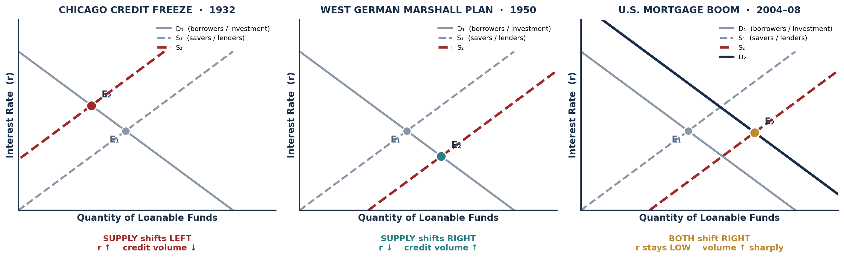
PART 4 · THREE CREDIT MARKET SHOCKS
1932 · 1950 · 2004–08
HISTORICAL CASE | WHICH CURVE, WHICH DIRECTION | INTEREST RATE | CREDIT VOLUME | REAL-WORLD CONSEQUENCE
Chicago Credit Freeze, 1932 | SUPPLY shifts LEFT — banks failed and lenders hoarded cash | ROSE | FELL | Firms could not finance investment; the collapse in lending DEEPENED UNEMPLOYMENT.
West German Marshall Plan, 1950 | SUPPLY shifts RIGHT — U.S. capital transfers flooded in for industrial rebuilding | FELL | ROSE | The 'Wirtschaftswunder' — economic MIRACLE. Cheap capital financed rapid reconstruction.
U.S. Mortgage Boom, 2004–08 | BOTH shift RIGHT — Fed rate cuts expanded supply; refinancing surged demand | STAYED LOW | ROSE sharply | Expansion MASKED major credit-risk exposure. The boom financed speculation, not productive capital formation.
INTRO TO MICROECONOMICS | PROF. VELAZQUEZ
MODULE 5: FACTOR MARKETS

Slide 23
SCENARIO 5.4 · UNITED STATES, 2004–2008
The Mortgage Boom & Worksheet ✦4
WHAT THE MODEL SAYS HAPPENED
1
WHAT THE MODEL PREDICTED
Fed rate cuts → SUPPLY of loanable funds shifts RIGHT.
Mortgage refinancing and housing speculation → INVESTMENT DEMAND shifts RIGHT.
Both curves right: quantity rises unambiguously; the rate outcome is AMBIGUOUS and in fact stayed low. This is the Module 3 double-shift framework, applied to a factor market.
Lower interest rates stimulate PRODUCTIVE INVESTMENT: firms undertake projects whose return exceeds the now-cheaper cost of capital, raising the capital stock and future output.
WHO BENEFITED, WHO BORE THE RISK
2
WHAT ACTUALLY HAPPENED
BENEFITED MOST from cheap credit: existing asset holders — homeowners who refinanced, mortgage originators paid on volume, and investors in mortgage-backed securities during the upswing.
BORE THE SYSTEMIC RISK in 2008: subprime borrowers who lost homes, taxpayers who funded the rescue, and workers who lost jobs in the recession that followed.
Cheap credit inflated a SPECULATIVE HOUSING BUBBLE rather than productive capital formation. Funds flowed into bidding up the price of an existing, fixed-supply asset — which raises no one's marginal product.
THE DISTRIBUTIONAL POINT
The people who captured the gains from cheap credit and the people who absorbed the losses were largely DIFFERENT PEOPLE. The loanable funds model tracks quantities and a rate; it does not track who is on either end of each contract. Module 7 does.
3
WHAT THE MODEL OMITS
· FINANCIAL REGULATION — the model has no concept of underwriting standards or leverage limits.
· BEHAVIORAL INCENTIVES — originators paid on volume, not on repayment. A principal-agent problem (Module 7).
· INFORMATION ASYMMETRY — buyers of mortgage securities could not observe the underlying loan quality. Akerlof's lemons problem (Module 12).
· ASSET vs. CAPITAL — the model does not distinguish borrowing to BUILD from borrowing to BID.
INTRO TO MICROECONOMICS | PROF. VELAZQUEZ
MODULE 5: FACTOR MARKETS

Slide 24
YOU TRY
Module 5 — Independent Practice
Complete all four Parts of the Module 5 Worksheet, including the VMP schedule, the word-bank ripple sequence, and all four diagrams.
Khan Academy: Factor Markets — derived demand, marginal revenue product, labor market equilibrium. Reach mastery.
Draw by hand: the land market with a vertical supply curve and a D₁→D₂ shift; the labor market with the Great Migration supply shift; the 1932 loanable funds contraction.
Answer reflection questions ✦1 through ✦4 in complete sentences. Each one asks where the competitive model stops explaining.
HOMEWORK RULE OF THUMB: above 80% → move on. Below 80% → retry once or twice. Consistently below 80% → office hours, immediately.
20
MIN
INTRO TO MICROECONOMICS | PROF. VELAZQUEZ

Slide 25
MODULE 5
What You Should Be Able to Do
 | LEARNING OUTCOME
Part 1 | Distinguish product from factor markets and state who supplies and who demands in each; define derived demand and explain why factor demand is never direct; state the two neoclassical assumptions and what each one is doing; compute VMP = P × MP from a marginal product schedule and identify the profit-maximizing employment level; trace the five-step distribution cycle.
Part 2 | Distinguish rental price from purchase price; explain why land supply is perfectly inelastic and draw the vertical supply curve; predict the effect of a demand shift on rent and on quantity; define economic rent; apply the Enclosure Movement case and map it onto a contemporary property market.
Part 3 | Draw a labor market with firms on the demand side and workers on the supply side; identify labor demand as the VMP curve; predict the effect of a supply shift on W* and L*; state the competitive prediction W* = VMP and name three structural reasons it may fail; explain why the ACL curve lies above labor supply under monopsony and why the resulting wage is below VMP.
Part 4 | Draw the loanable funds market with the interest rate as the price; identify savers as suppliers and borrowers as demanders; predict the effect of a supply or demand shift on r and on credit volume; analyze the 1932, 1950 and 2004–08 cases; name at least three variables the loanable funds model omits.
NEXT
MODULE 6 — THE BRIDGE. We have built the whole microeconomic toolkit. Module 6 asks what it explains about the last three centuries of global growth and divergence — and what it leaves out.
INTRO TO MICROECONOMICS | PROF. VELAZQUEZ
MODULE 5: FACTOR MARKETS

Slide 26
MODULE 5
References
Allen, R. C. (2009). The British Industrial Revolution in global perspective. Cambridge University Press.
Clark, G. (2007). A farewell to alms: A brief economic history of the world. Princeton University Press.
Mankiw, N. G. (2021). Principles of microeconomics (9th ed.), Ch. 18. Cengage.
Manning, A. (2003). Monopsony in motion: Imperfect competition in labor markets. Princeton University Press.
Neeson, J. M. (1993). Commoners: Common right, enclosure and social change in England, 1700–1820. Cambridge University Press.
Parthasarathi, P. (2011). Why Europe grew rich and Asia did not. Cambridge University Press.
Ricardo, D. (1817). On the principles of political economy and taxation. London: John Murray.
Wilkerson, I. (2010). The warmth of other suns: The epic story of America's Great Migration. Random House.
Boustan, L. P. (2009). Competition in the promised land: Black migration and racial wage convergence in the North. Journal of Economic History, 69(3), 755–782.
Mian, A., & Sufi, A. (2014). House of debt. University of Chicago Press.
INTRO TO MICROECONOMICS | PROF. VELAZQUEZ
MODULE 5: FACTOR MARKETS

